Slide 1

Department of Computer Science &Engineering
( rArtificial Intelligence & Machine Learning)
A.P. Shah Institute of Technology G.B.Road , Kasarvadavli, Thane(W), Mumbai-400615
UNIVERSITY OF MUMBAI
Academic Year 2023-2024

Slide 2
Project Management
By
Jay Yadav (23206007)
Manas Jagtap (23206011)
Soham Waradkar (23206002)
pranal vernekar (23206008)

Slide 3
INDEX
Introduction
Objectives
Block diagram
Tools/Software, languages used
Implementation
Conclusion
reference

Slide 4
Introduction
The Project Management Application is a software solution designed to streamline and simplify the project management process. In today's fast-paced world, efficient project management is critical for success, and this application has been created to meet the growing demands of project management.

Slide 5
Objective
The primary objective of our Project Management Application is to revolutionize and optimize project management, with a focus on improving project outcomes & overall administrative efficiency. Our specific objectives include:
Simplify Project Management
Efficient Task Assignment
Recognize Achievements
Secure User Authentication

Slide 6
Features
Customization: Allow manager to tailor projects to specific needs.
User Achievements: Assign batches to the users.
Resource Management: Resource allocation and scheduling.
Task Management: Efficient Task Management.

Slide 7
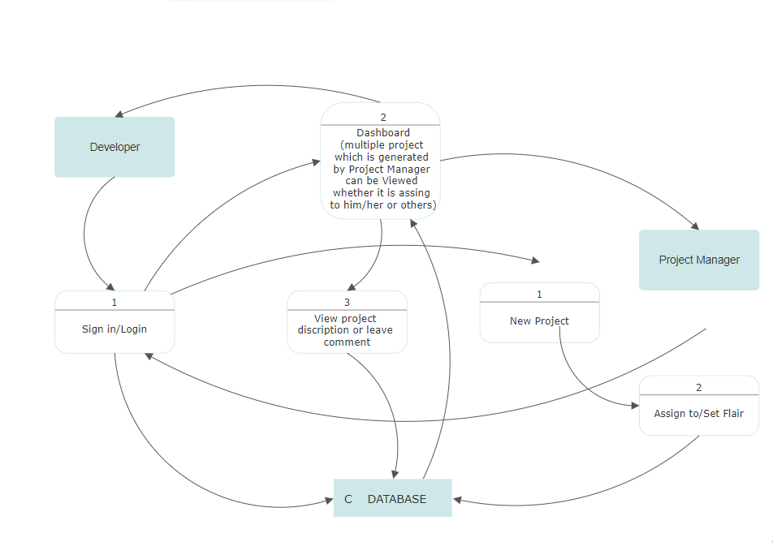
Block Diagram

Slide 8




Tools/Softwares Used
Visual studio code
React JS
CSS
Firebase

Slide 9
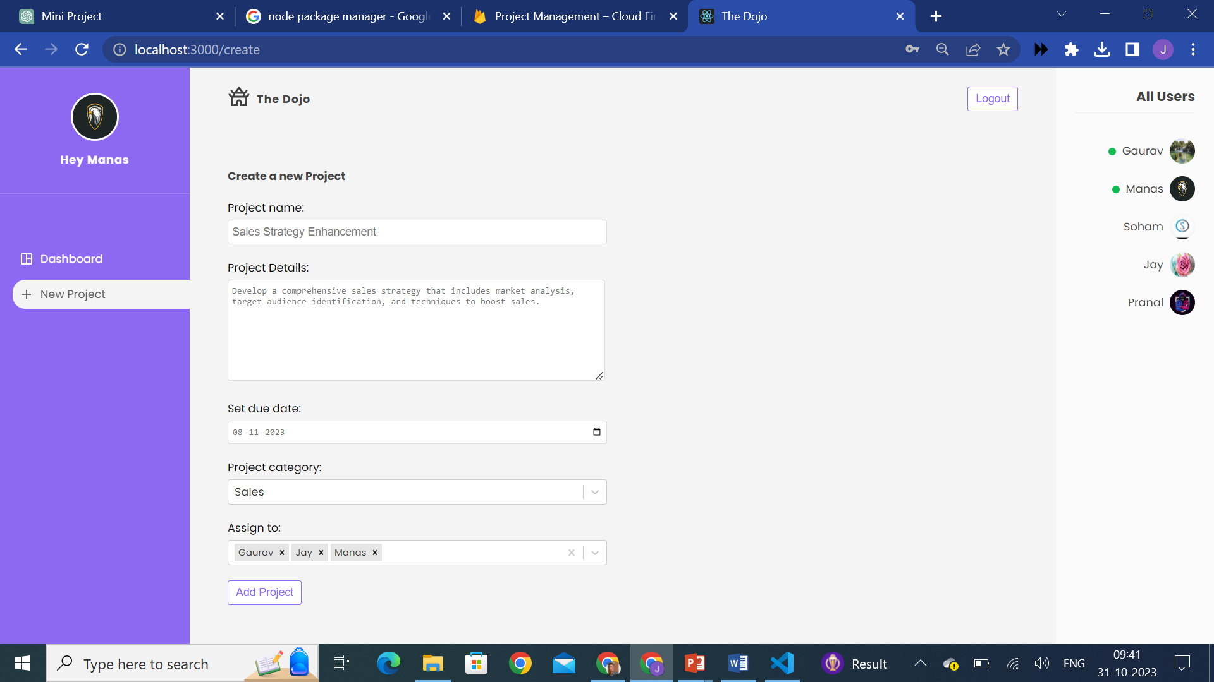
Implementation

Slide 10
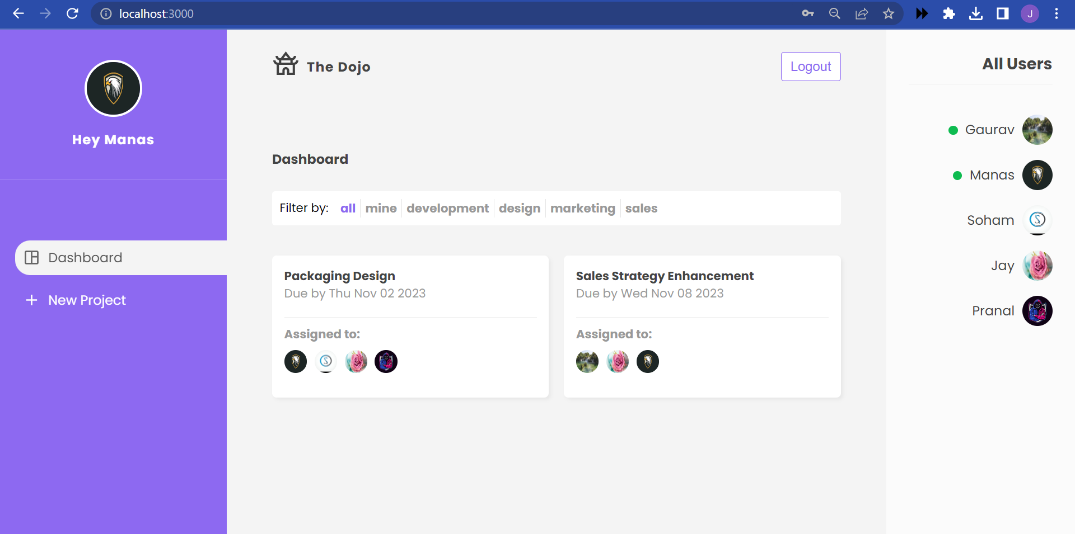

Slide 11
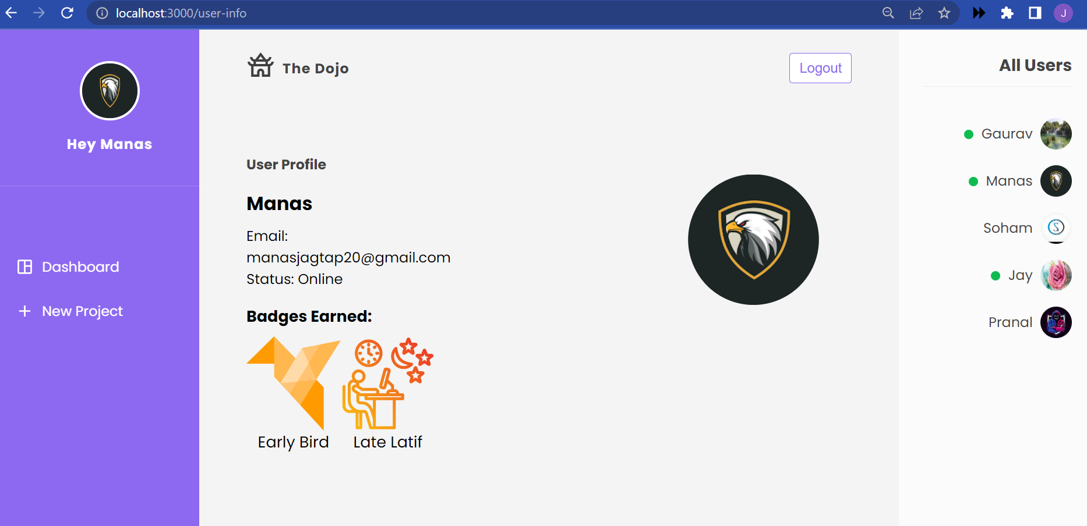

Slide 12
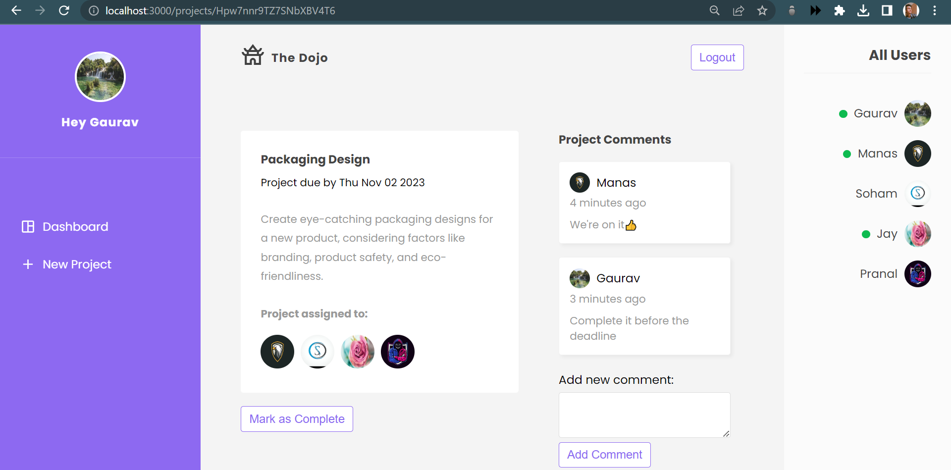

Slide 13
Conclusion
In conclusion, project management applications are invaluable tools for organizations and teams of all sizes and industries. These applications offer a comprehensive set of features and functionalities that streamline the project lifecycle, from planning and execution to monitoring and reporting. The key benefits of using project management applications include improved project efficiency, enhanced collaboration, better resource allocation, and the ability to make data-driven decisions.

Slide 14
References
[1] “Project Management",Dr. Alamelu Mangai Raman, Dr. P. Shanthi, Dr. Domenic T. Sanchez, San International Scientific Publications, 2023
[2] “Evaluation of Impact of Project Management", Olawe Hammed Gazal, Rukayat Pelumi, International Journal of Interdisciplinary Research, 2023
[3] “Agile Project Management", Raymond John Uzwyshyn, Research Gate Publications, 2023
[4] “Proactive Project Management", Dmytro Shadura, Victor Melenchuk, Research Gate Publications, 2023

